Slide 1

Introduction to machine learning

Slide 2
Important things
Types of learning and models – or “using the right tool for the job”
Preprocessing – or “how not to lose the battle before it’s begun”
Training processes – or “how to keep models from cheating”
Metrics – or “how to mark your model’s work”
Hyperparameters
AI Ethics – how not doing the above can lead to poor models, and AI is not objective!

Slide 3
Very important BIT
The mathematics behind these models can get complicated. The key is to understand the intuition behind what the model is doing.

Slide 4
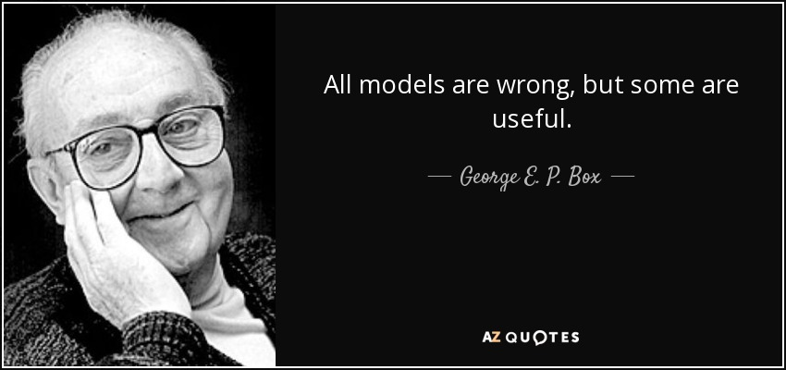
The MOST IMPORTANT BIT

Slide 5
Types of model
Learning process: Supervised vs Unsupervised
Type of problem: Regression, Classification, dimensionality reduction, clustering etc
Amount of data available
“Deep” vs “Shallow” learning

Slide 6
Preprocessing
Statistical tests will often make assumptions about our data (normality etc).
So do machine learning models
Luckily, we can usually transform our data in some way to better fit this assumption for the model, and then change it back after.

Slide 7
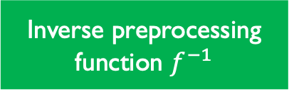
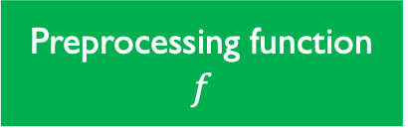
Preprocessing
Data
Preprocessing function $f$
Interpretable by us
Interpretable by the model
Model
Result
Inverse preprocessing function $f^{−1}$

Slide 8
Preprocessing
Many ways to preprocess data
Might involve something far more complex (even another model!)
Often times this decision is informed by how your data looks, and what model you’re using.

Slide 9
Examples
Scikitlearn has amazing documentation and does a better job at explaining than I could ever do!

Slide 10
OTHER Examples
PCA (when we get to it) is a common preprocessing step for clustering algorithms
Greyscaling images for image processing
EQ/filtering for noise data

Slide 11
Model validation
Models will always try and maximize/minimize a metric, and are very good at finding optimal but unhelpful solutions
Very important to have “sight unseen” data that your model tests on to make sure it’s not overfitting.

Slide 12
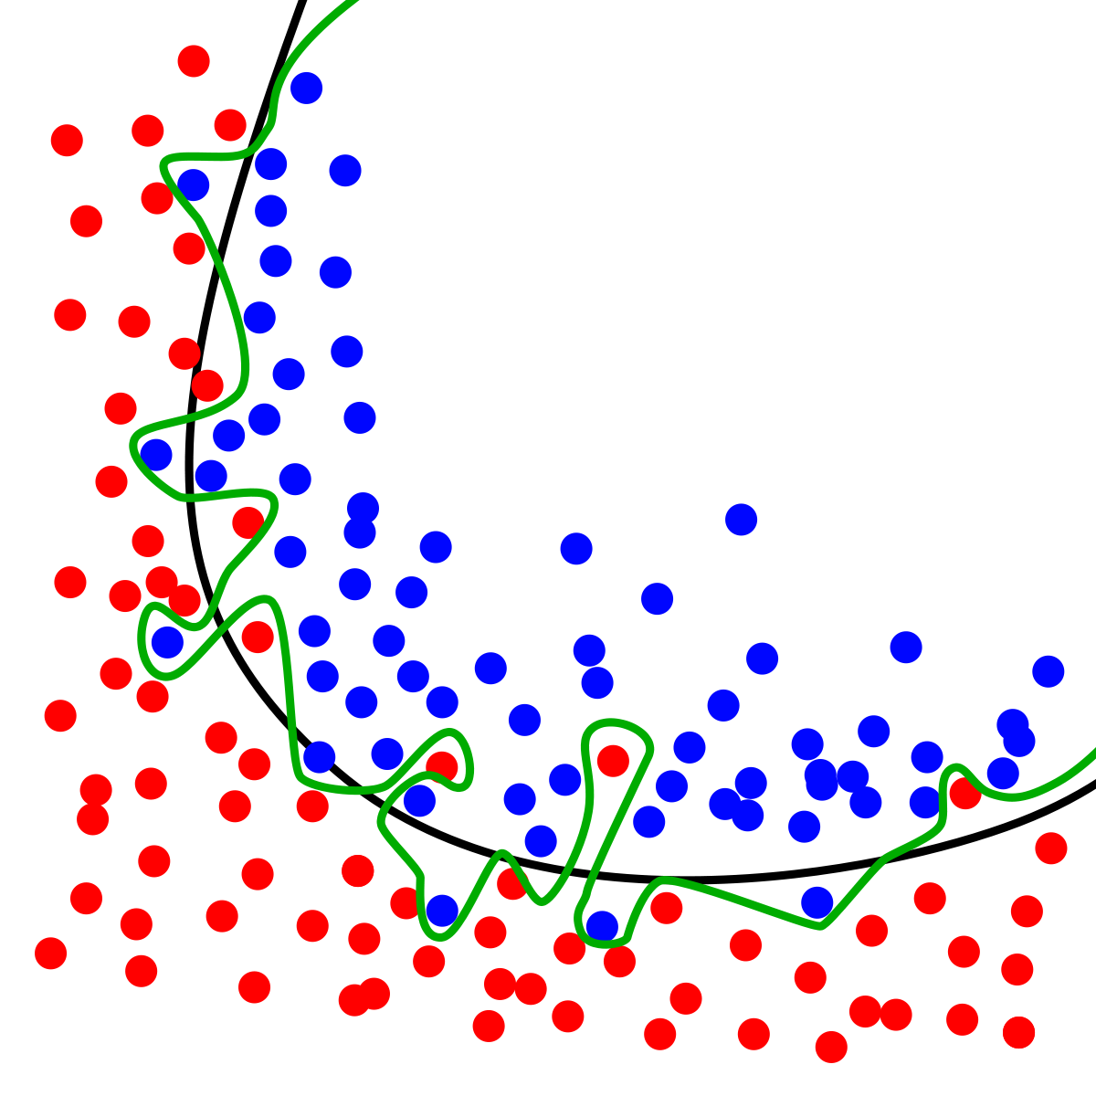
OVERfitting
This is a segmentation model (splitting the space in two, a “red zone” and a “blue zone”. The black and green lines represent two models. Which is more accurate? Which is more helpful?

Slide 13
Common solutions
Split dataset into a training and testing set (typically 80/20 split)
If a model’s performance is very high on training, but very low on testing, you are likely overfitting.
Sometimes you will use an additional “validation” dataset during training that the model does not train on, but uses to track learning and make adjustments.
Cross validation is more rigorous train test splitting

Slide 14
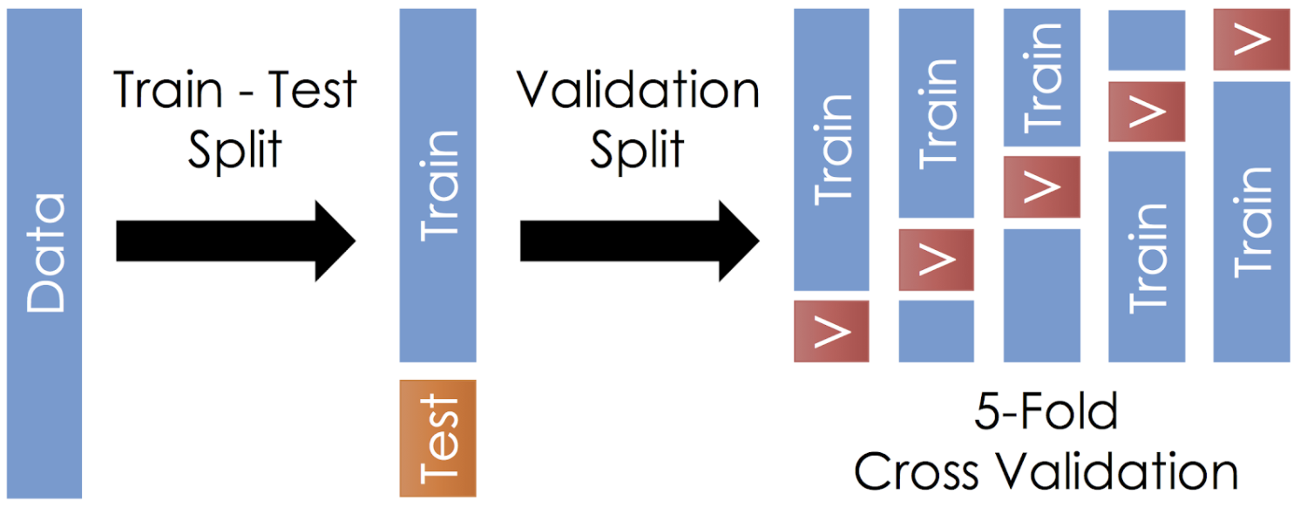
Common solutions

Slide 15
METRIcs
What do we want our model to be good at?
How are we measuring success?
Are there any ways the model might try and “cheat” these metrics?
Are there any ways we might try and “cheat” these metrics?

Slide 16
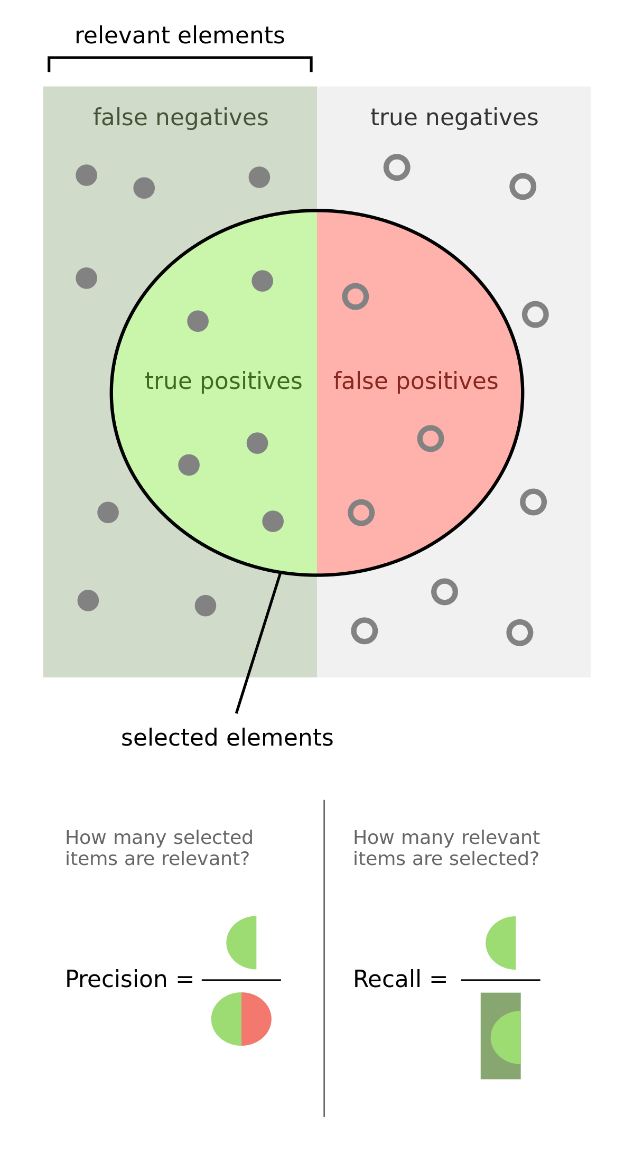
METRIcs

Slide 17
Precision and recall alone aren’t good metrics
If using only precision, it incentivizes extremely “conservative” models. Extremely low false positive (FP) rate at the cost of extremely high false negative (FN) (bad for screening for illness for example)
If only using recall, it incentivizes extremely “liberal” modes. Extremely low false negatives at the cost of extremely high false positives (recommendation systems want to show you as many relevant items as possible, even if most of them aren’t helpful)

Slide 18
Can we do better?
Taking the accuracy (% correct guess overall) might seem intuitive, but for imbalanced datasets doesn’t work too well.
F1-Score is another metric that takes balancing into account
Other metrics available and highly dependent on what you need

Slide 19
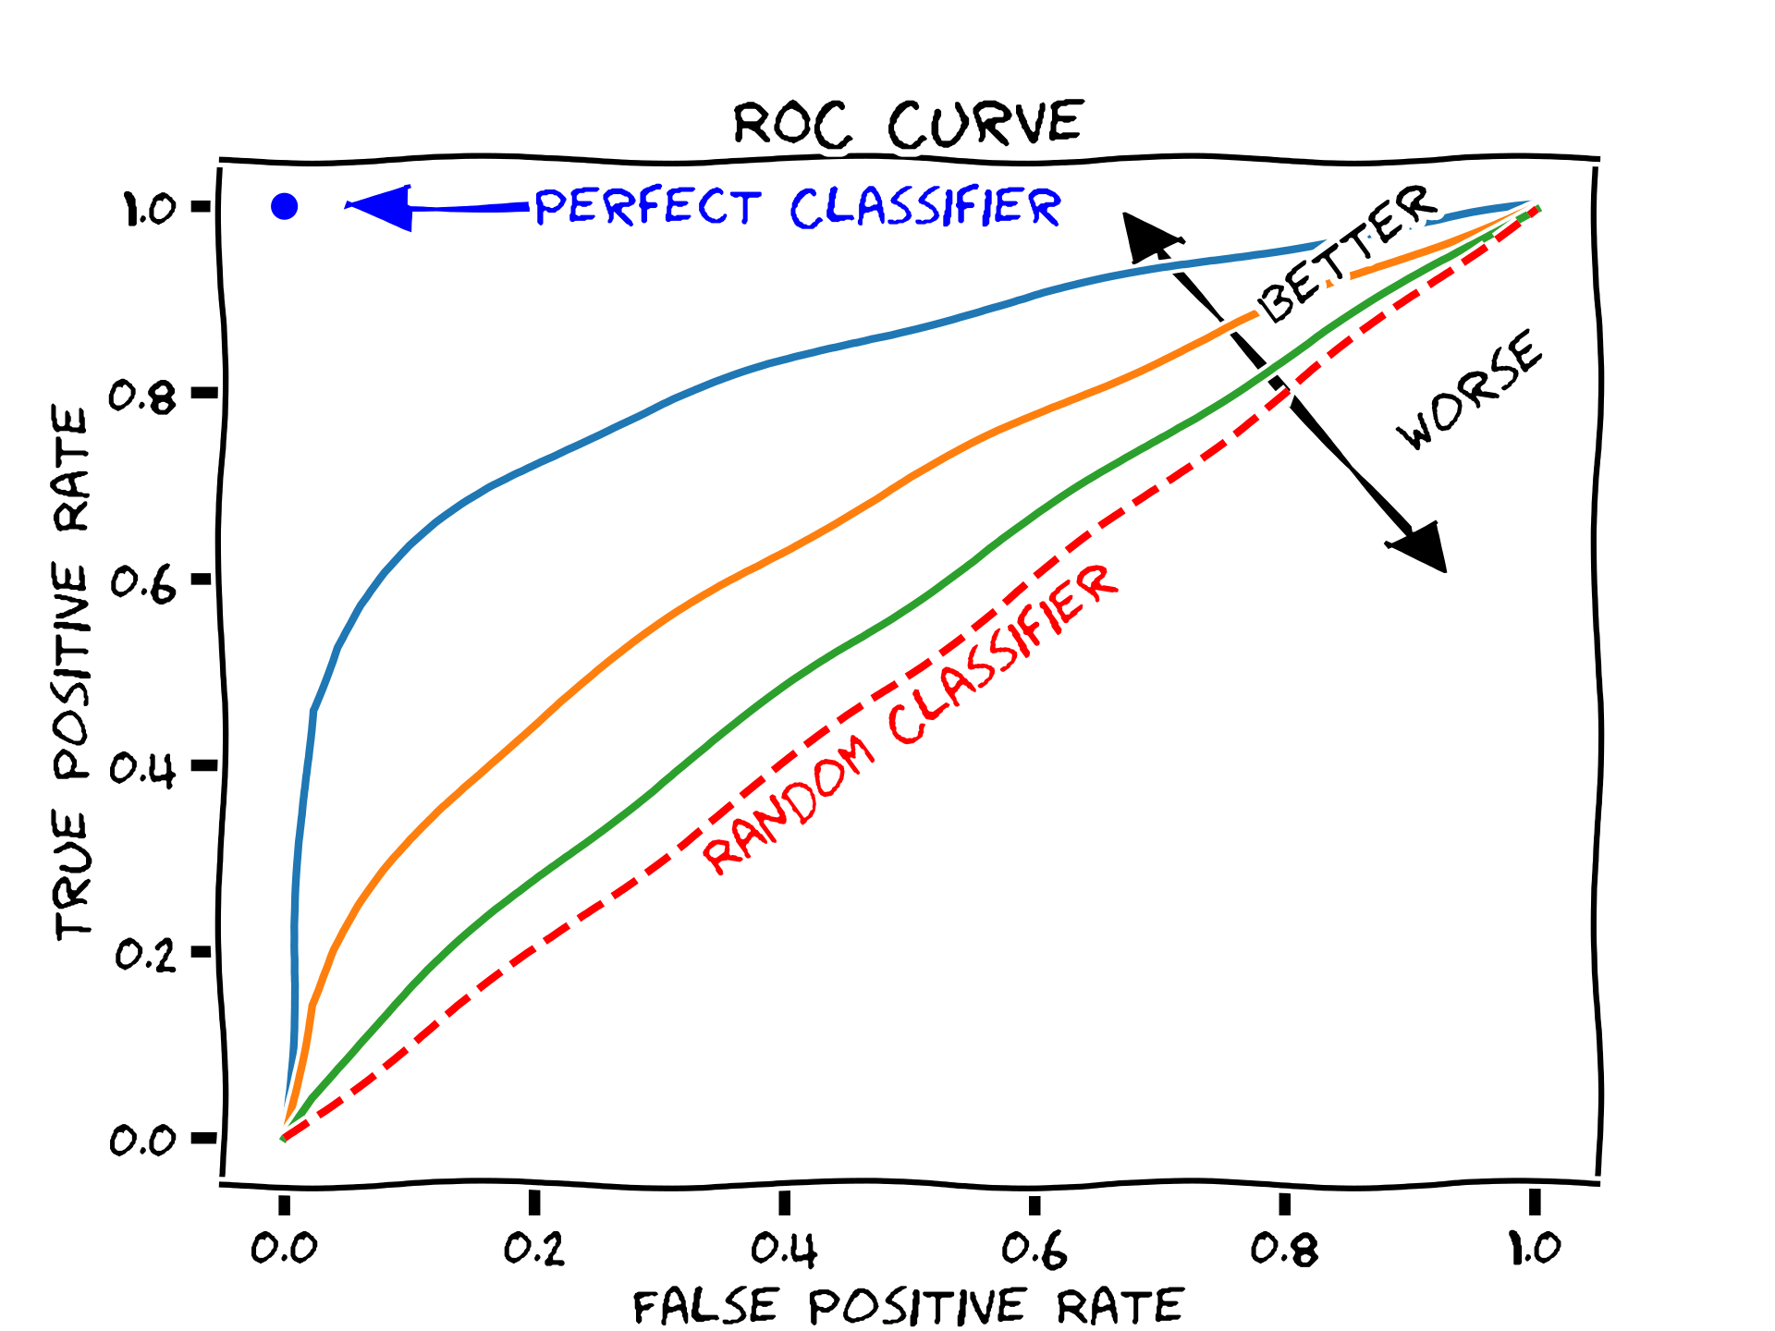
ROC Curves

Slide 20
HYPERPARAMETERS
Models are min/maxing a function and changing parameters as they go
But they do this based on a series of assumptions we give it
For example in k-means clustering or k-nearest neighbours, we decide “k” before training starts. In neural networks there are lots of these!
It’s another source of overfitting. K=N for KNN will give 100% accuracy on training dataset.
Methods for choosing best hyperparameters including grid search etc.

Slide 21
AI Ethics
Awful AI
“People vs algorithms”
AI as a reflection of ourselves and our data
Honesty within AI reporting and repeatability - are our models really as good as we say?

